Slide 1

Biomedical Image Processing: Processing images in GrayScale
Paul Vu 301169550 January 13th 2017

Slide 2
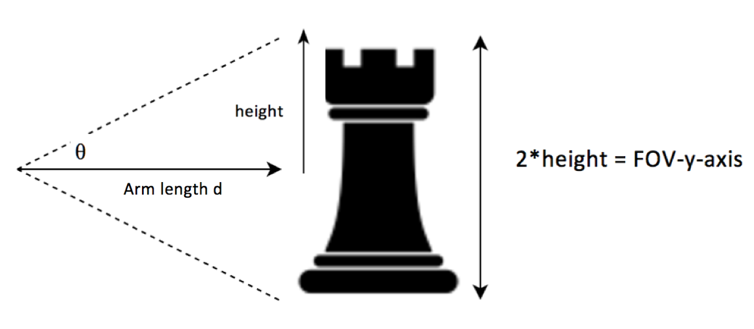
Determining FOV: Intuition
Figure 1: Selfie FOV illustration
Estimated Arm length d = 360 mm
Estimated θ for iPhone 5 front facing camera = 27° since the iPhone 5 lens has a 54° FOV as found on:
https://www.boinx.com/chronicles/2013/3/22/field-of-view-fov-of-cameras-in-ios-devices/

Slide 3
Determining FOV: Calculations
Figure 1: Selfie FOV illustration
Height = (Arm length d)* tanθ
= 360 * tan(27)
FOV-y-axis = 2*Height
= 2* 360 * tan(27)
= 366.85 mm
Thus, the Field of View in the vertical direction is 366.85 mm.

Slide 4

Determining Resolution: Intuition
After importing the mugshot into MATLAB we know the image is 1280x960 samples
Total y-axis samples = N_{y} = 1280
Total x-axis samples = N_{x} = 960
From part 1 we know our FOV-y-axis is 366.85mm therefore we can calculate the FOV-x-axis in mm by comparing the ratios in the x/y axis
From there we can solve for Δx and Δy which represent the resolution in mm as depicted in lecture 2 page 2 : Δx $=\frac{FOVx}{Nx }$ || Δy $=\frac{FOVy}{Ny }$

Slide 5

Determining Resolution: Calculations
$\frac{y−axis resolution in mm}{x−axis resolutioin in mm}$ = $\frac{366.85 mm}{x−axis resolution in mm}$ = $\frac{1280}{960}$
Therefore, x-axis resolution in mm = $\frac{960}{1280}$*366.85 mm = 275.14 mm
N_{y} = 1280 N_{x} = 960
FOV_{x} = 275.14 mm
FOV_{y} = 366.85 mm
Substituting Δx $=\frac{FOVx}{Nx }$ || Δy $=\frac{FOVy}{Ny }$
Δy $=\frac{366.85}{1280}$ = 0.29 mm
Δx $=$ $\frac{275.14}{960}$ = 0.29 mm
Therefore we have a resolution of 0.29 mm in both the x and y sample axis.

Slide 6
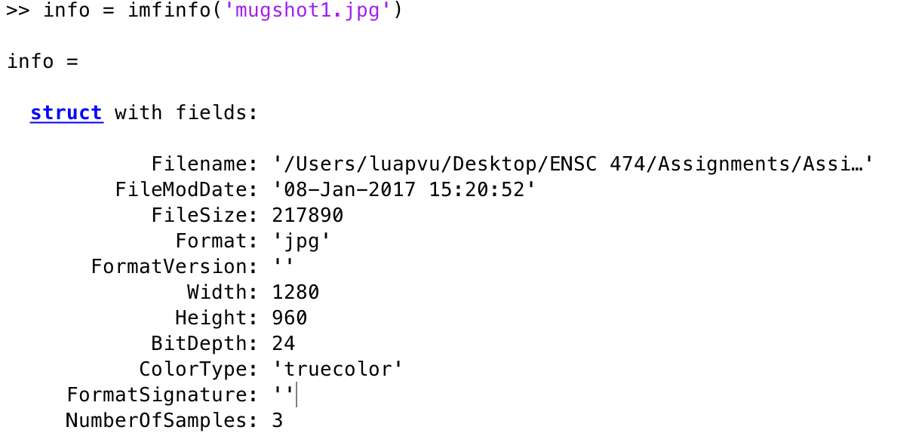
Number of samples in x-y dimensions
From MATLAB, we can see that there are 1280 y-samples and 960 x-samples.
Figure 2: iminfo results of mugshot

Slide 7
Number of bits used per sample
Intuition:
Each sample contains an R-G-B component. Since each component is represented by 8 bits in MATLAB, each sample will have an 8 bit Red, 8 Bit Green and 8 Bit Blue component.
Calculation:
8-bit Red + 8-bit Green + 8-bit Blue = 24 bit RGB representation per sample
Therefore, each sample is represented by 24 bits.

Slide 8

Total bits required to store the image
Intuition:
There are 1280*960 samples of 24bits. There are 8 bits in 1 byte.
Calculations:
$\frac{\left(1280∗960 samples\right)∗\left(24 \frac{bits}{sample}\right) }{(8\frac{bits}{byte})}$ = 3,686,400 bytes

Slide 9
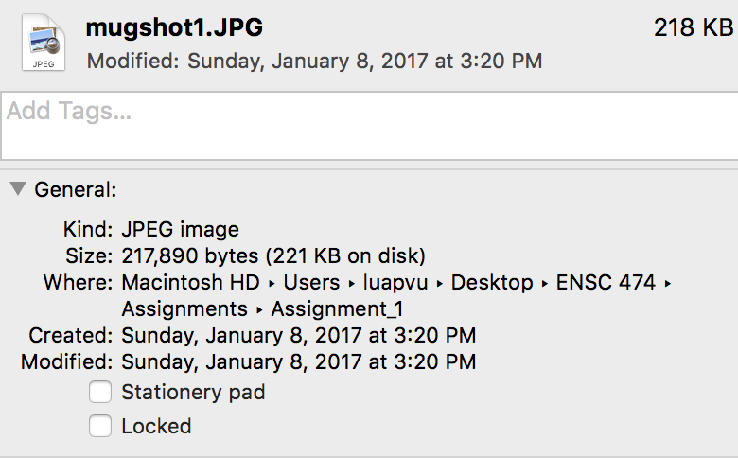
Actual image size on disk
From the image properties, we can see that the JPEG image has been compressed to 217, 890 bytes.
Figure 3: Mugshot image properties on MAC

Slide 10

Compression ratio
Calculation:
Number of bits on disk = 217, 890 bytes
Required total number of bits = 3,686,400 bytes
Compression ratio = $\frac{217,890 bytes }{3,686,400 bytes}$ = 0.0591 = approximately 16:1 compression ratio. We can see that JPEG has significantly compressed the photo.

Slide 11
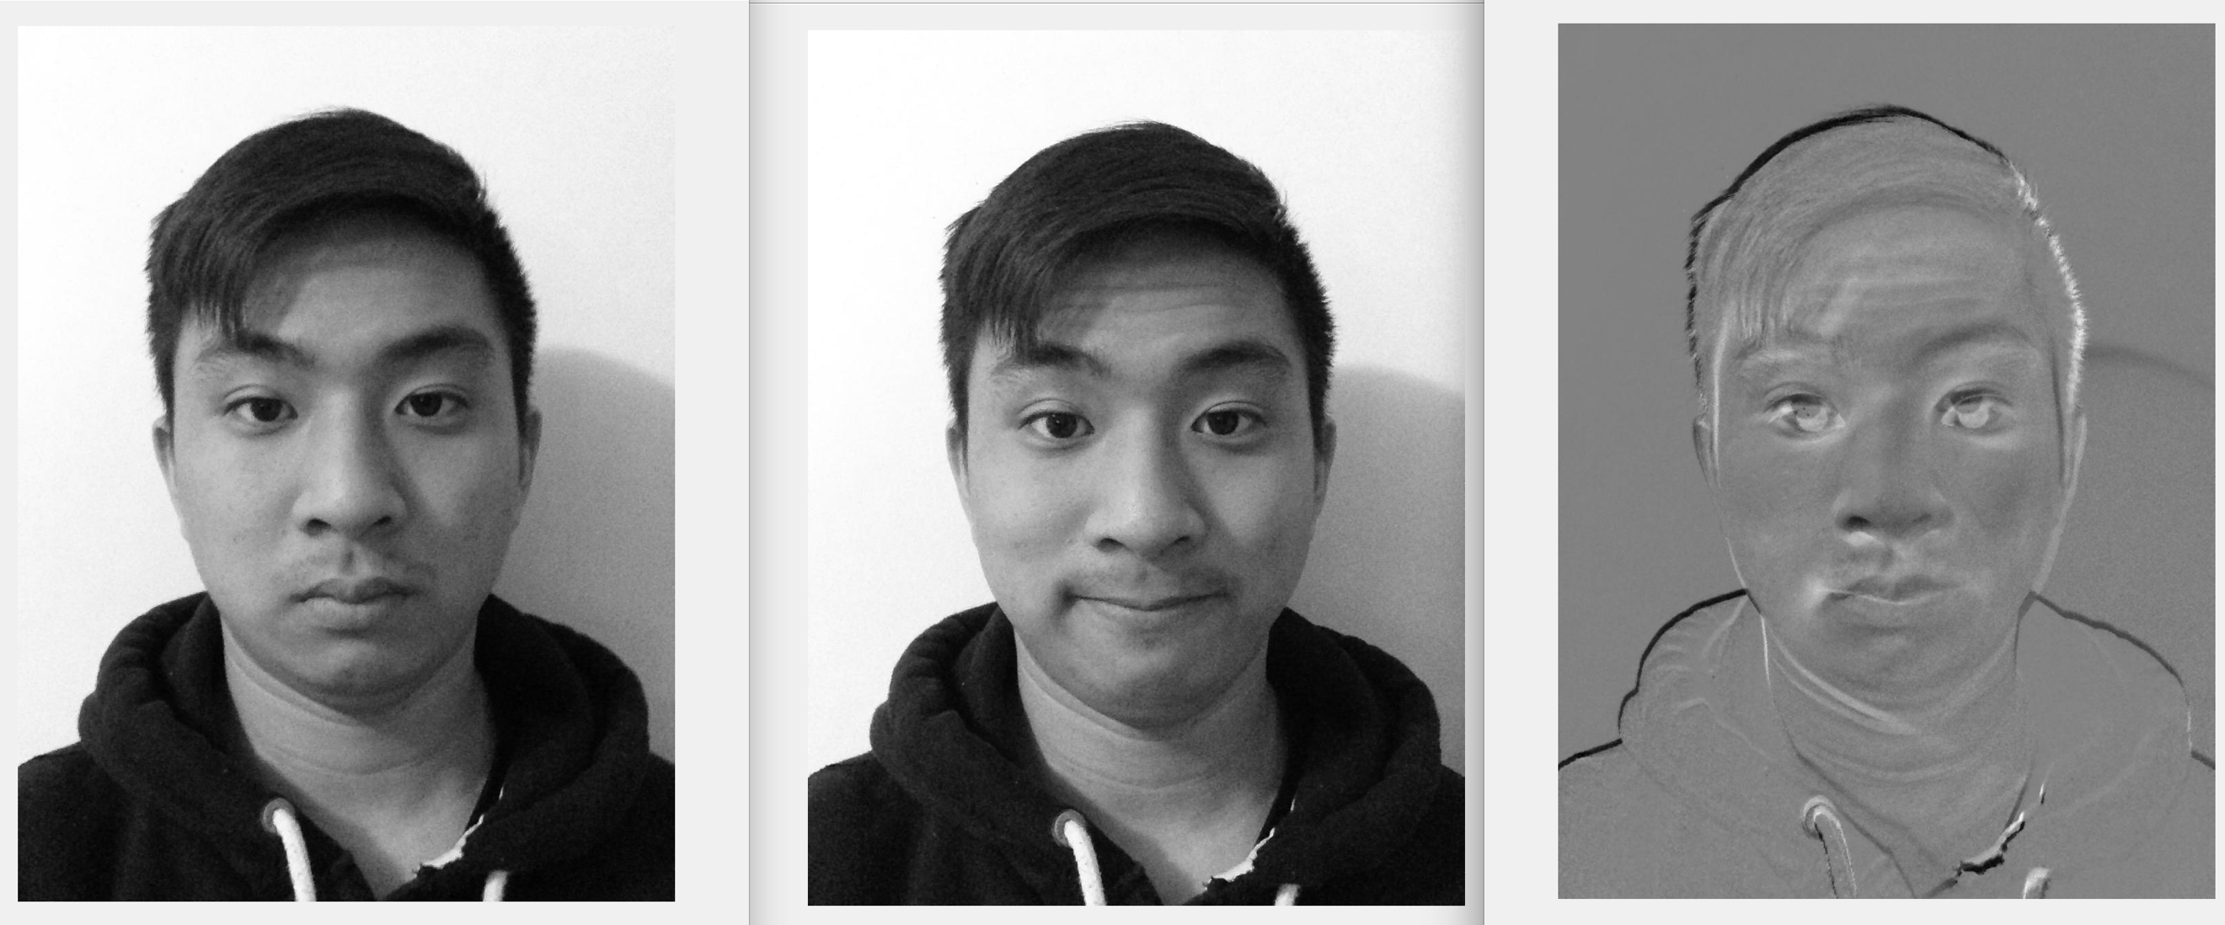
Assignment Results
To replicate these results please run Assignment1_main.m which is the main script.
Figure 4: From left to right, we have a mugshot in gray scale, smile shot in gray scale and the resulting difference image when the two images are subtracted with each other

